Slide 1

SOURCE
WELL-PREPARED PROJECTS
INNOVATING IN THE DIGITAL AGE TO CHANGE THE WAY INFRASTRUCTURE IS DEVELOPED

Slide 2
SOURCE – Added Values
SOURCE brings to its users the following benefits
Well-prepared project: The project preparation process is supported by a standardised project definition template resulting from an advanced selection of best international practices.
Enhanced project management: The platform ensures robust data from the outset and supports the decision-making by project managers by streamlining the collection, aggregation and display of critical information provided by the users.
Interactive sharing and access: Supports collection of data and sharing of information and real-time access to the project platform through an interactive interface.
Fostering project outreach: Well-prepared quality label supports the engagement with the project stakeholders i.e. project preparation pipelines, IFIs, private sector, etc.
Fostering project financing: Project development is supported by informing on project eligibility to private and public financing facilities.

Slide 3
SOURCE – Added Values
Fostering project funding: The platform supports a government in assessing and selecting the possible options at its disposal to cover the project expense.
Supporting project monitoring: The platform supports the assessment of the project during its preparation, procurement, development and operating phases.
Assessment of project portfolio: An assessment and selection of the most viable and feasible projects among a government’s project portfolio can be made through a set of reliable and advanced standardised parameters.
Supporting project analytics: The platform processes data and analytics, which support the identification and assessment of trends, pipelines of projects and markets achievements, in various jurisdictions of the world.
Free support system: The platform is an international public good that is free for national and subnational governments to support their infrastructure project preparation capacities.

Slide 4

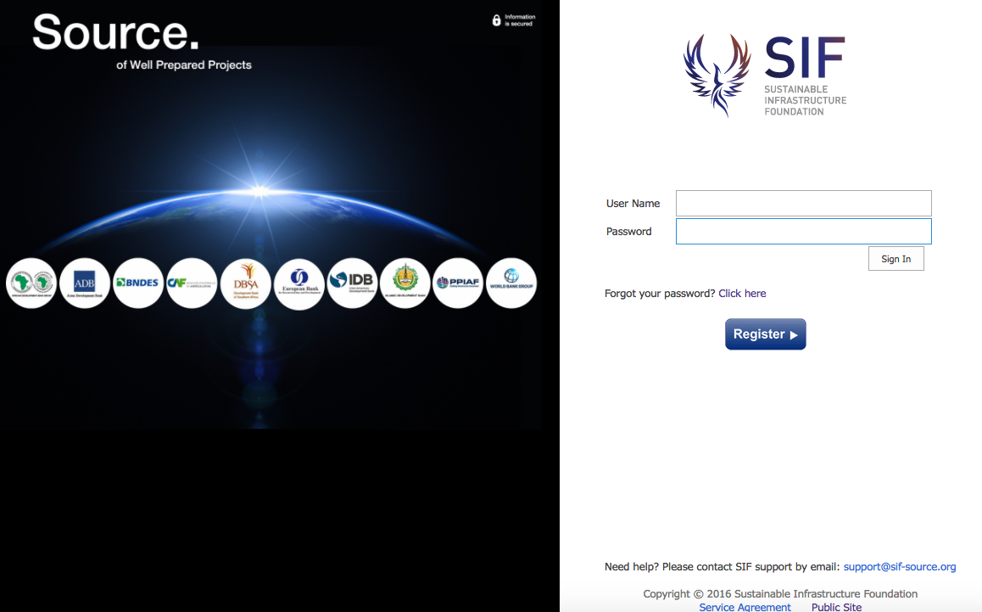

Governance
Private Donors
Public Donors / Multilateral Funding
Strategic Partners Committee
Advisory Committee
Africa Investor
Carbon 60
IIFCL
IMF
ISCA
KPPIP
PIDG
R20
WEF
Executing
Agency
AfDB
AsDB
BNDES
CAF
DBSA
EBRD
IaDB
IsDB
WBG

Slide 5
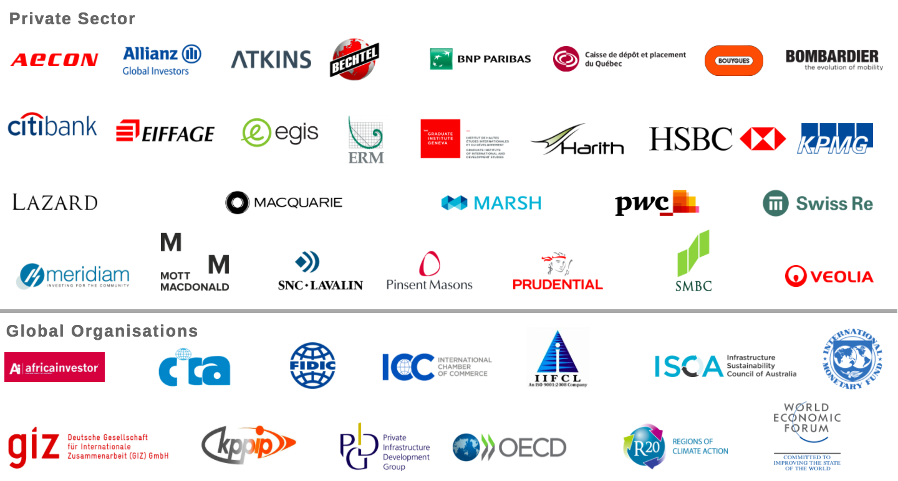
Working in Association with SIF

Slide 6
GLOBAL SUBSECTOR TEMPLATE REVIEW
Template comments
Template reviewers
Template subsectors
5500+
300
37

Slide 7
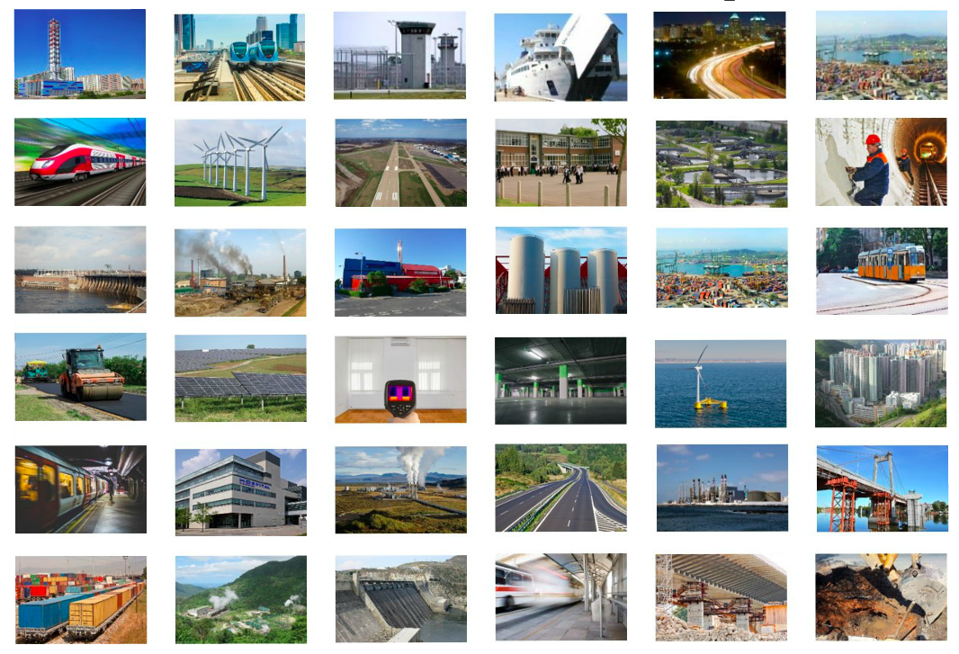
SUBSECTOR TEMPLATES

Slide 8
GLOBAL OUTREACH
1100+ users





142+ projects


1.5 years of operation

“SOURCE provides a holistic analysis to prepare and structure complex infrastructure projects.”


40+ Countries


USD 31+ billion




Slide 9
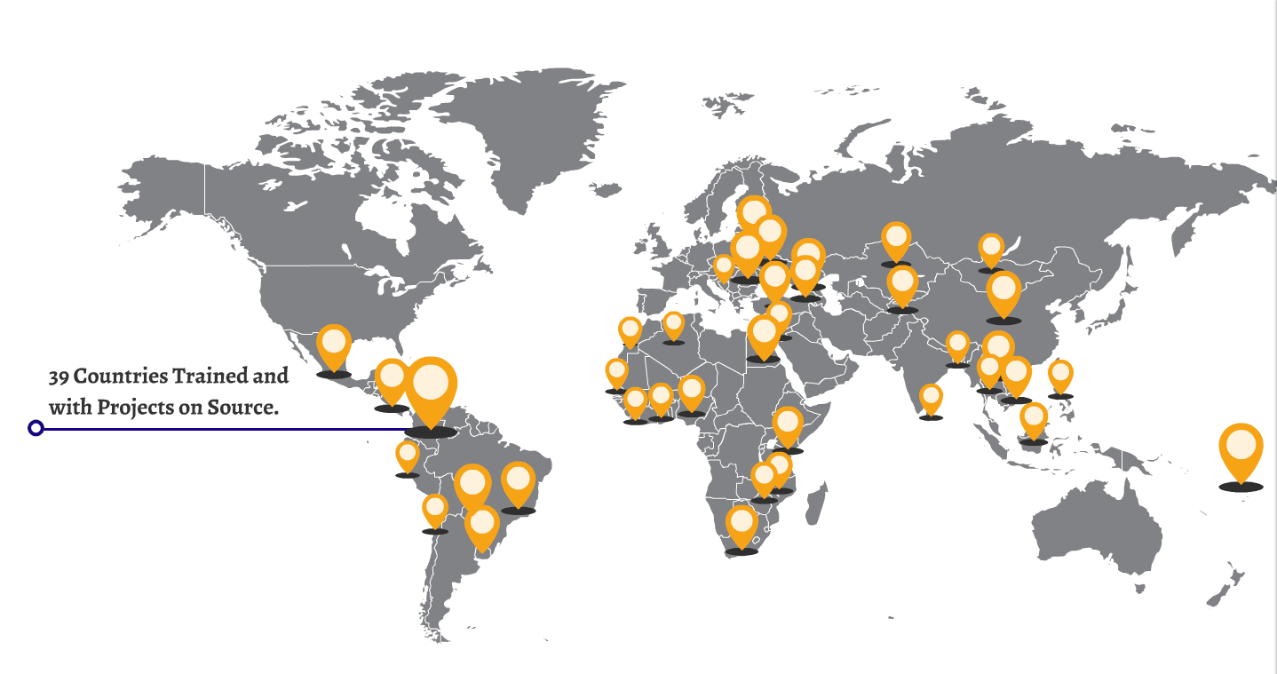
GLOBAL OUTREACH
142 Projects
49%
51%
Standard
Procurement
PPP
10 Energy

23 Social Infrastructure

65 Transport

18 Urban Services

26 Water and waste

Slide 10
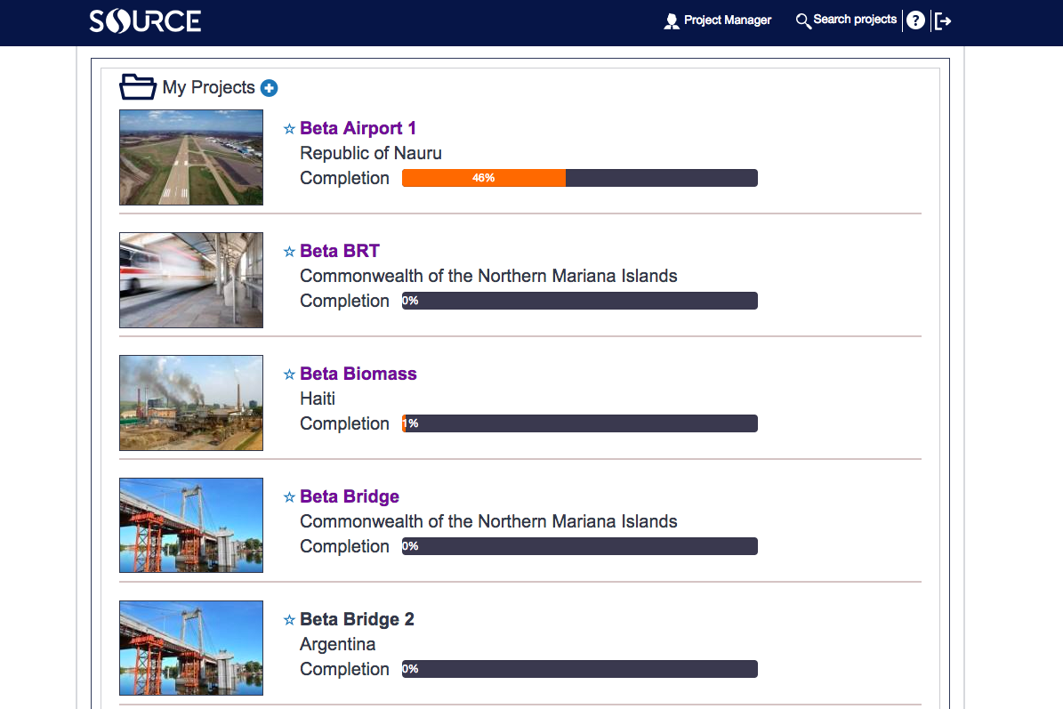

Slide 11
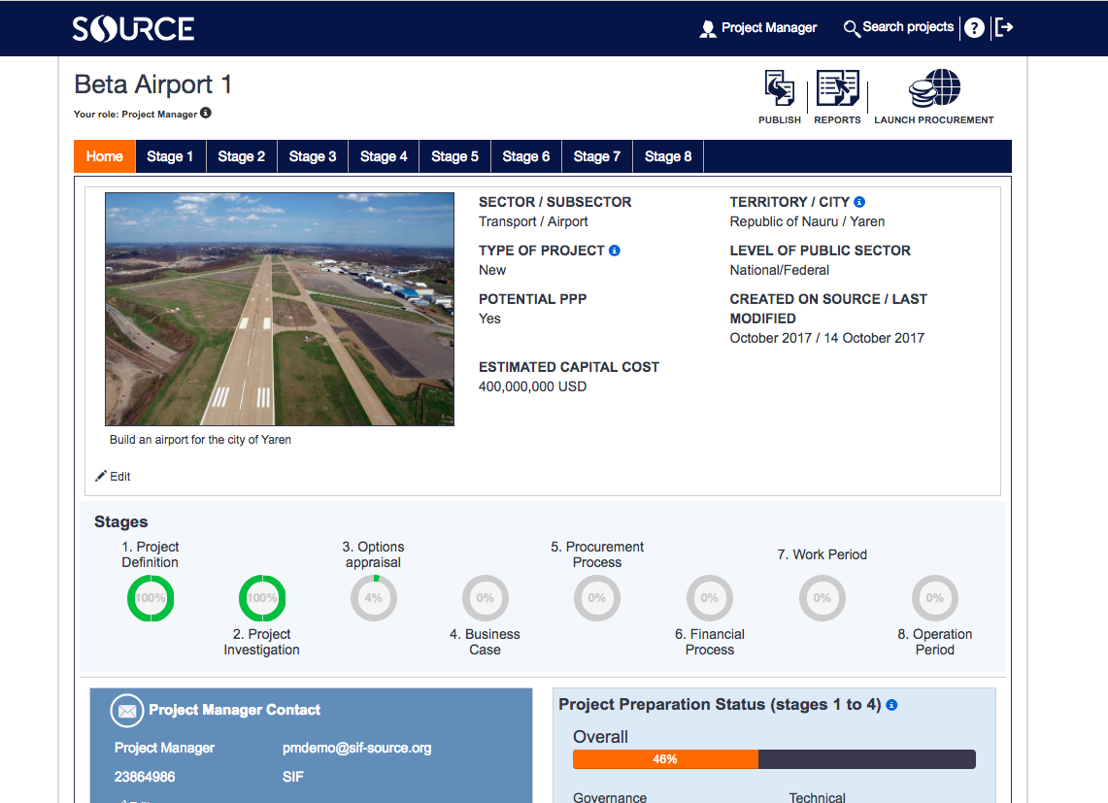

Slide 12

Sustainable Infrastructure Foundation
2 avenue Henri-Dunant
1205 Geneva, Switzerland
support@sif-source.org

