Slide 1
Conclusions of B20 Germany and ways forward with B20 Argentina CICA Conference

Slide 2
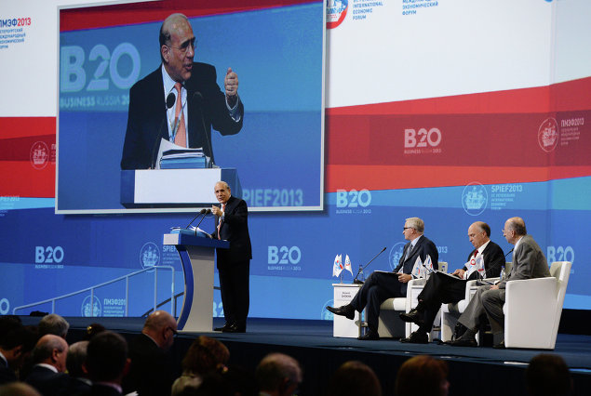
About B20
The B20 is an integral part of the G20 process, representing the entire G20 business community
The mission of the B20 is to support the G20 through consolidated representation of interests, concrete policy proposals, and expertise
Joint recommendations and specific policy actions across the entire G20 agenda

Slide 3
Financing Growth & Infrastructure Taskforce

Slide 4
Taskforce constituent key roles & responsibilities

Slide 5
Financing Growth & Infrastructure taskforce structure

Slide 6
2017 Germany B20 event timeline

Slide 7
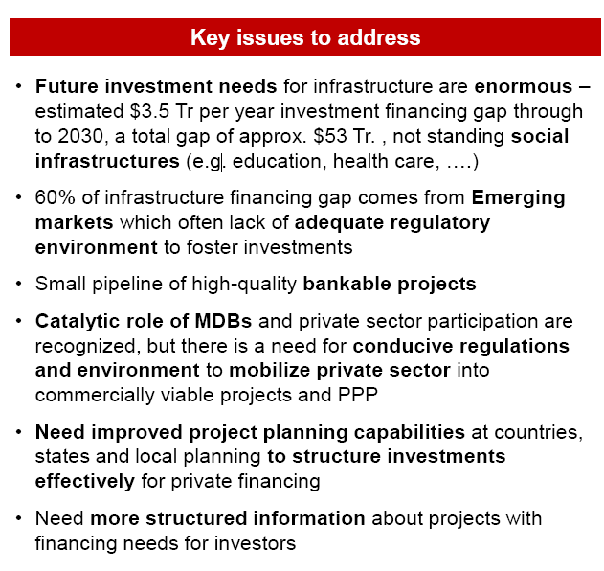
B20 Germany priorities: the infrastructure financing gap
While infrastructure investment needs are enormous, a number of impediments prevent full private sector mobilization

Slide 8
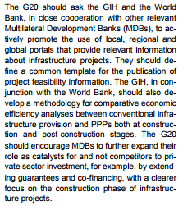
B20 Recommendations to the G20

Slide 9
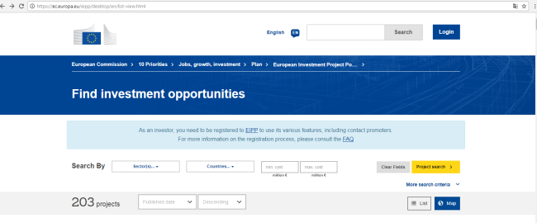
B20 Recommendations to the G20
According to FIEC, a greater clarification should be given in the use of some words. Maybe the word « pipeline » should be specified. FIEC thinks that a distinction should be made between platforms and portals. Platforms refer to the project preparation activities and the improvement of the quality of projects by providing standardized templates . The SOURCE platform is a good example for delivering well-prepared projects
Portals of projects refer to tools aiming at facilitate visibility and knowledge sharing. In this context, portals should allow access to project information through standardization of documentation. The European Investment Project Portal launched by the European Commission in June 2016 is a good example
More broadly, FIEC considers that a bottom up approach is needed. The identification of local and regional projects is a crucial issue and the MDBs could play an important role in that process

Slide 10
B20 Recommendations to the G20
→ Ways forward
B20 Argentina 2018

