Slide 1
The Israeli Construction Sector Overview & Statistics December, 2019

Slide 2
The Israel Builders Association
The only official organization of construction sector members in Israel. Established 1949. Incorporates 13 local Associations
2,200 members – contractors & developers for home building, infrastructure and all other construction work
Represents the sector interests with government ministries, Local Government, BOI, CBS, ISI, etc.
Represents the employers in the Collective Labor Agreement with the General Organization of Workers. Operates a Bipartite Mediation Committee for employers and workers
Plans and oversees on-site assessment of foreign workers to be employed in Israel - molding, masonry, flooring, plastering
Founded CONTECH - Construction-tech hub providing construction companies access to high-tech innovation. A joint project of the IBA and the Israeli Government

Slide 3
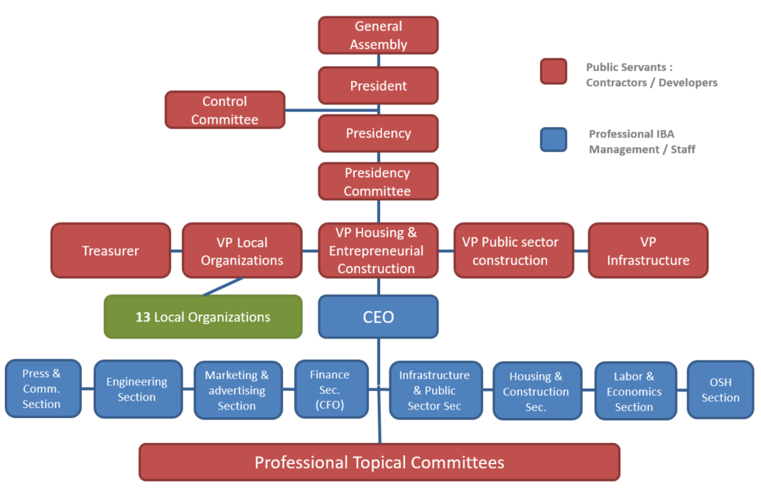
The Israel Builders Association

Slide 4
2018 Macro Environment
Area 22,000 sq km
Population 8.9 m +2%
GDP $369 b +3.3%
GDP per capita $41,700 +1.3%
Unemployment 4%
Real wage growth 2.7%
Inflation 0.8%
BOI Interest Rate 0.25%
Government Debt as part of GDP 61%

Slide 5
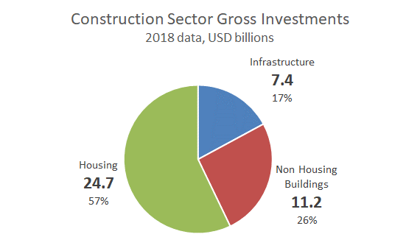
Israeli Construction Sector Size
Source : Israel Central Bureau of Statistics
Share of GDP 11.4%
Avg real growth per year over the past 5 years 3.9%
Avg housing real growth per year over the past 5 years 3.5%

Slide 6
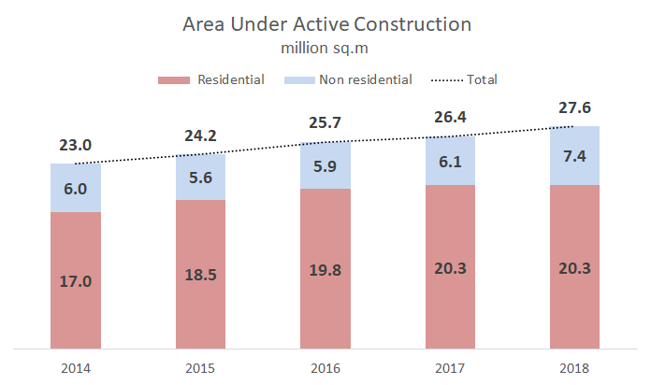
Active Construction
Number of dwellings in active construction 118,000
Source : Israel Central Bureau of Statistics

Slide 7
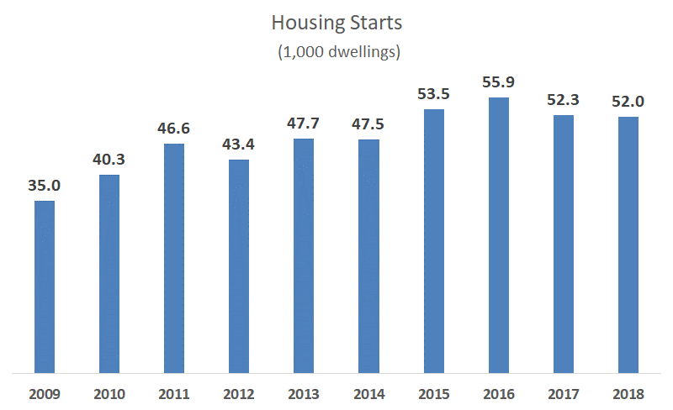
Housing Starts
Increase over past decade 49%
Drop in the last 3 yrs 7%

Slide 8
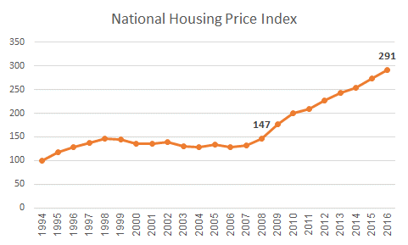
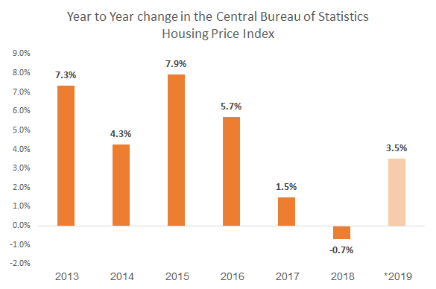
Housing Prices : a Dacade Long Problem
The price of houses in Israel have doubled since 2008 while the rise in the average salary has been much smaller (21%).
144 average salaries are required to buy an average apartment in Israel
In France : 76 / in US : 66 / in Holland : 59 / in Sweden : 30

Slide 9
The Housing Sector in Numbers
Government land ownership – 93%
Household home ownership - 69%
About 110,000 housing transactions per year – 25% new
Almost 50% of housing starts and transactions – in the Tel Aviv and central Israel
About 70% of new housing units are flats in dense urban settings
Most new multi-family dwellings : 4-5 rooms / 110 sqm actual living space in mid-rise buildings
Average price per new dwelling – $470,000

Slide 10
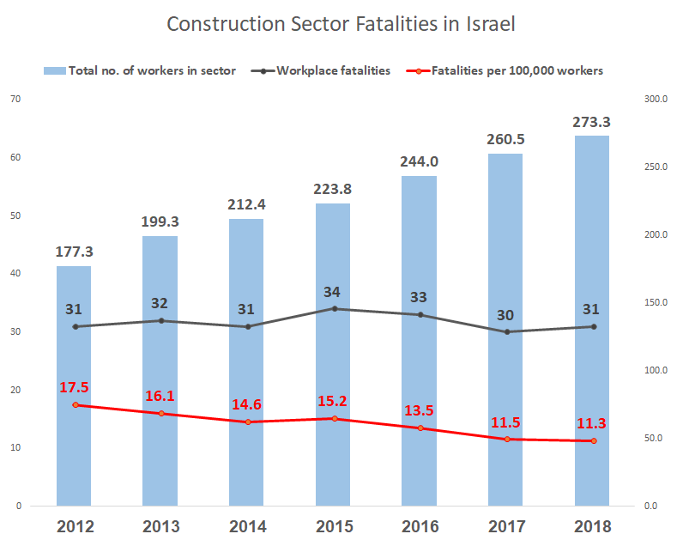
Israel Construction Fatalities
Sources: https://employment.molsa.gov.il/Publications/News/Pages/%D7%9DccupationalSafetyReport2013-2017.aspx
Israel Data does not include passers-by and traffiic accidents on and off
Number of Israeli workers – Central Bureau of Statistics, Palestinians and Foreigners – Israel Population and Immigration Authority and IBA
54% The rise in total number of construction sector employees
-35% The change in the number of fatalities per 100,000 employees since 2012

Slide 11
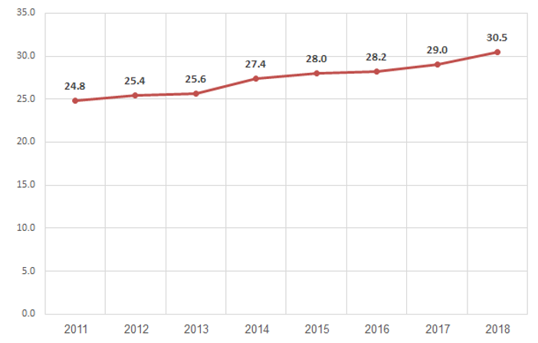
Housing Construction Time (months)
Source : CBS

Slide 12
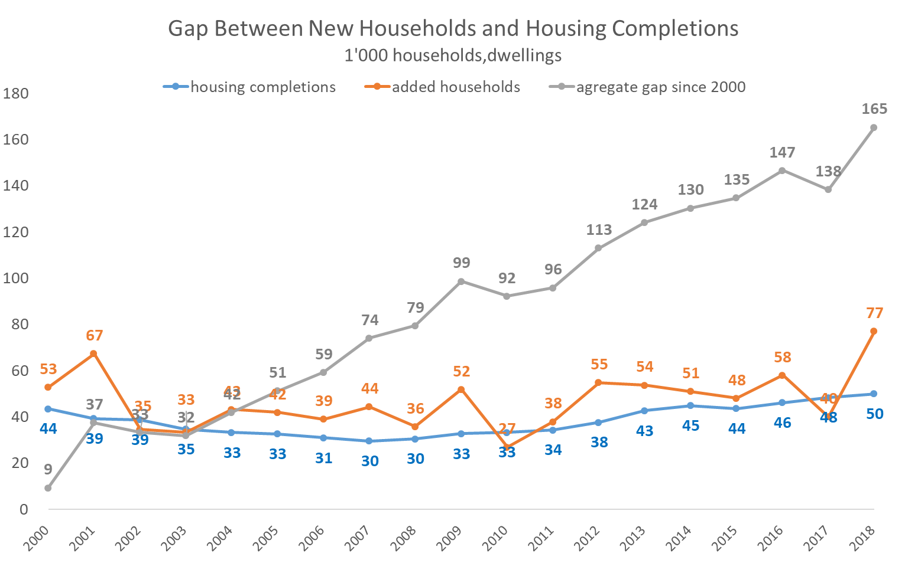
The Residential Housing Gap
This gap illustrates the housing supply gap and is one of the drivers of housing price rises
Notes:
Household formation is growing at an increasing rate which is now higher than population growth (1.8%-2%)
The long term trends : higher divorce rates, more single parent households, more single person households
This will influence the demand planned and built dwellings – 2.5 m dwellings in 25-30 years

Slide 13
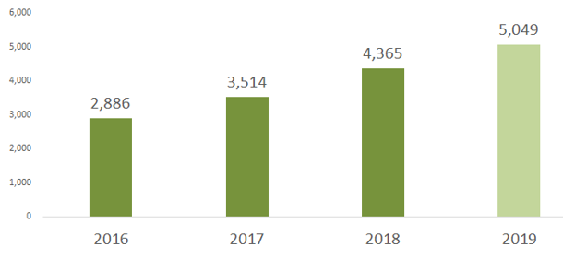
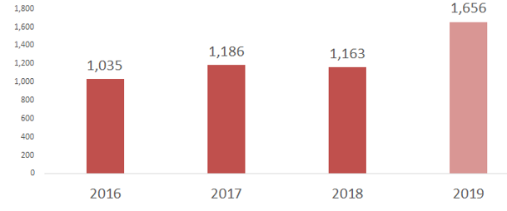
Non Residential Construction
Total Non Residential Buildings (1,000 sqm)
Government and Municipal Buildings (1,000 sqm)

Slide 14
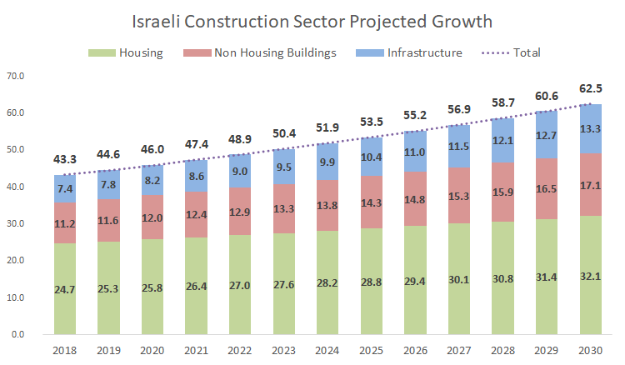
Projected Market Growth
2.2% projected yearly growth in housing. 5% projected growth in Infrastructure construction

Slide 15
Thank you

