Slide 1
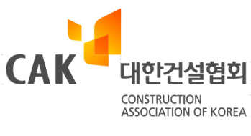
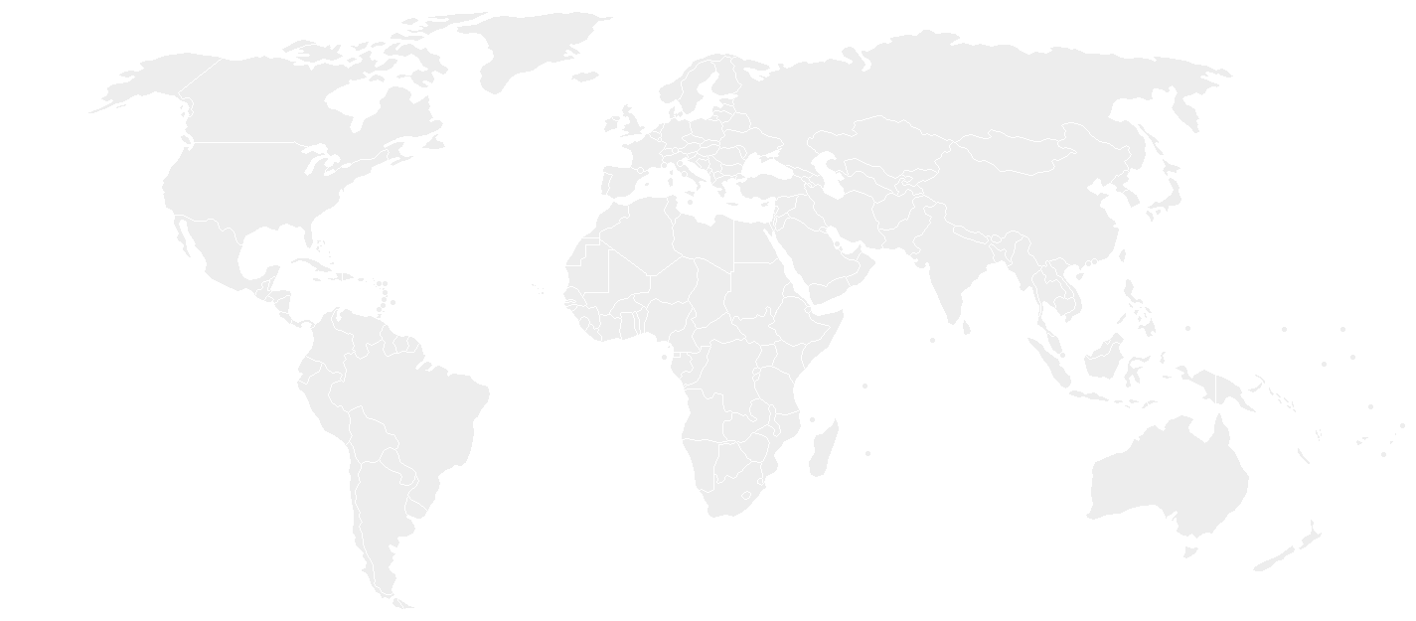
Toll Road
HEPP
PPP Projects of South Korea(Domestic and Overseas)
Tae-won, Park
Construction Association of Korea(CAK)

Slide 2
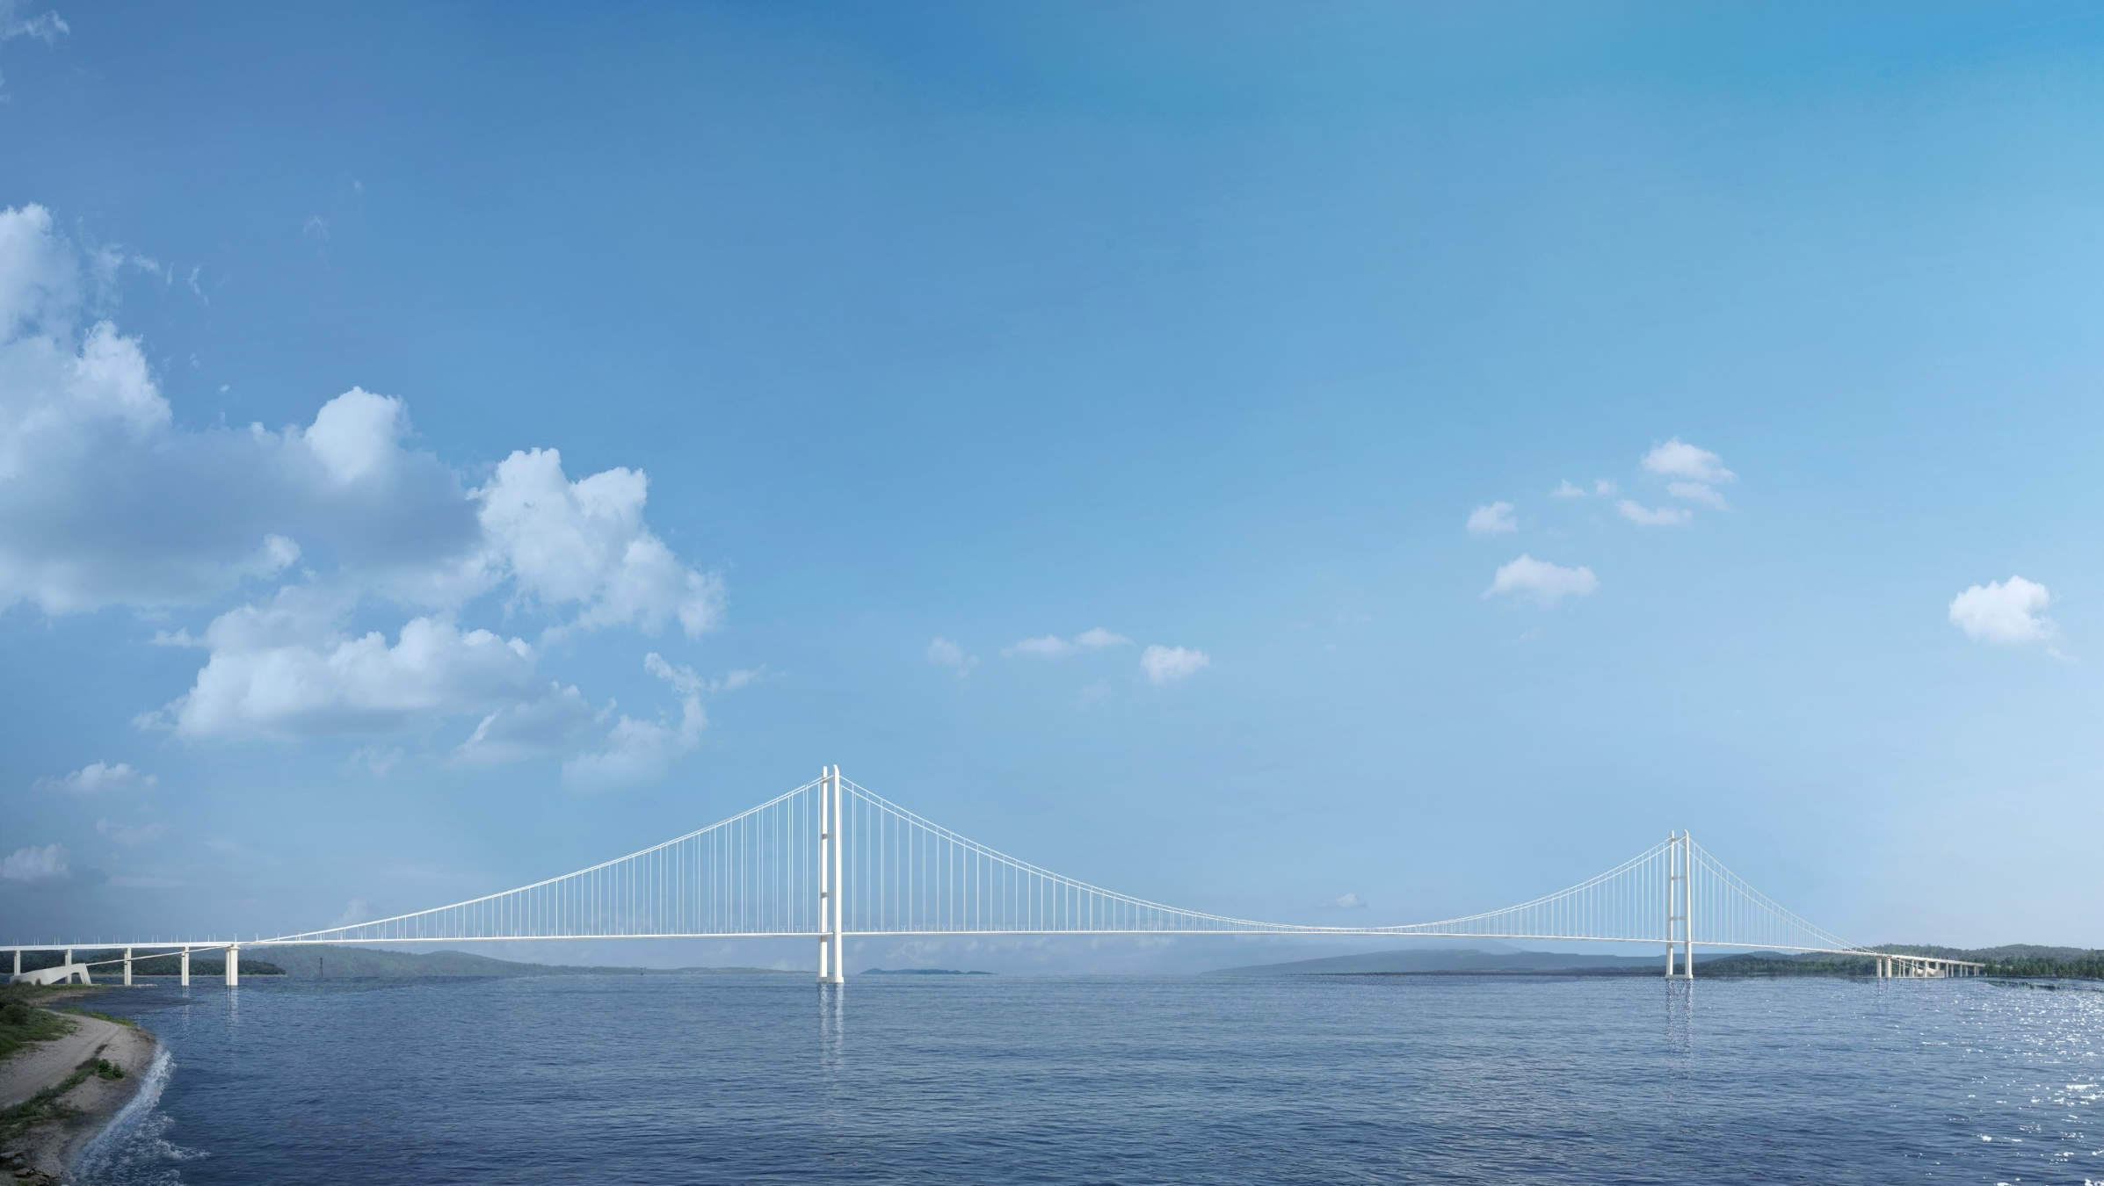
Contents
1
Current State of South Korea’s Construction Industry
2
Domestic PPP Project : Shinbundang DX Line PPP Project
3
Overseas PPP Project : ① Pakistan Gulpur Hydropower Project
4
Overseas PPP Project : ② Turkey Canakkale Bridge Project
5
Overseas PPP Project List and Economic Impact
1915 Canakkale Bridge ,Turkey

Slide 3
Current State of South Korea’s Construction Industry
□ Proportion of Construction Investment to GDP
※ billion USD
Year | GDP | Construction Investment | proportion
2013 | 1429 | 213 | 14.9%
2014 | 1,486 | 218 | 14.7%
2015 | 1,564 | 233 | 14.9%
2016 | 1,642 | 258 | 15.7%
2017 | 1,730 | 287 | 16.6%

Slide 4
Current State of South Korea’s Construction Industry
□ Proportion of Type of Construction Investment
※ billion USD
Type | 2013 |  | 2014 |  | 2015 |  | 2016 |  | 2017
 | sum | proportion | sum | proportion | sum | proportion | sum | proportion | sum | proportion
Total | 213.1 | 100.0% | 218.3 | 100.0% | 233.1 | 100.0% | 258.1 | 100.0% | 287.0 | 100.0%
Building | 131.4 | 61.7% | 142.0 | 65.1% | 156.6 | 67.1% | 183.2 | 70.9% | 212.1 | 73.9%
- Housing | 55.4 | 26.0% | 62.6 | 28.7% | 74.7 | 32.0% | 90.5 | 35.1% | 107.3 | 37.4%
- Non-residential Building | 76.0 | 35.7% | 79.4 | 36.4% | 81.9 | 35.1% | 92.7 | 35.9% | 104.8 | 36.5%
Civil Engineering | 81.6 | 38.3% | 76.4 | 35.0% | 76.4 | 32.7% | 74.9 | 29.0% | 74.8 | 26.1%

Slide 5
Current State of South Korea’s Construction Industry
□ Proportion of Public and Private to Construction Investment
※ billion USD
 | 2013 |  | 2014 |  | 2015 |  | 2016 |  | 2017
 | sum | Proportion | sum | Proportion | sum | Proportion | sum | Proportion | Sum | Proportion
Total | 213.1 | 100.0% | 218.3 | 100.0% | 233.1 | 100.0% | 258.1 | 100% | 287.0 | 100.0%
Private | 166.7 | 78.2% | 175.1 | 80.2% | 188.1 | 80.7% | 209.4 | 81.1% | 232.8 | 81.1%
Public | 46.4 | 21.8% | 43.2 | 19.8% | 44.9 | 19.3% | 48.7 | 18.9% | 54.2 | 18.9%

Slide 6
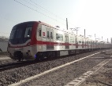
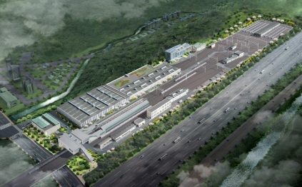
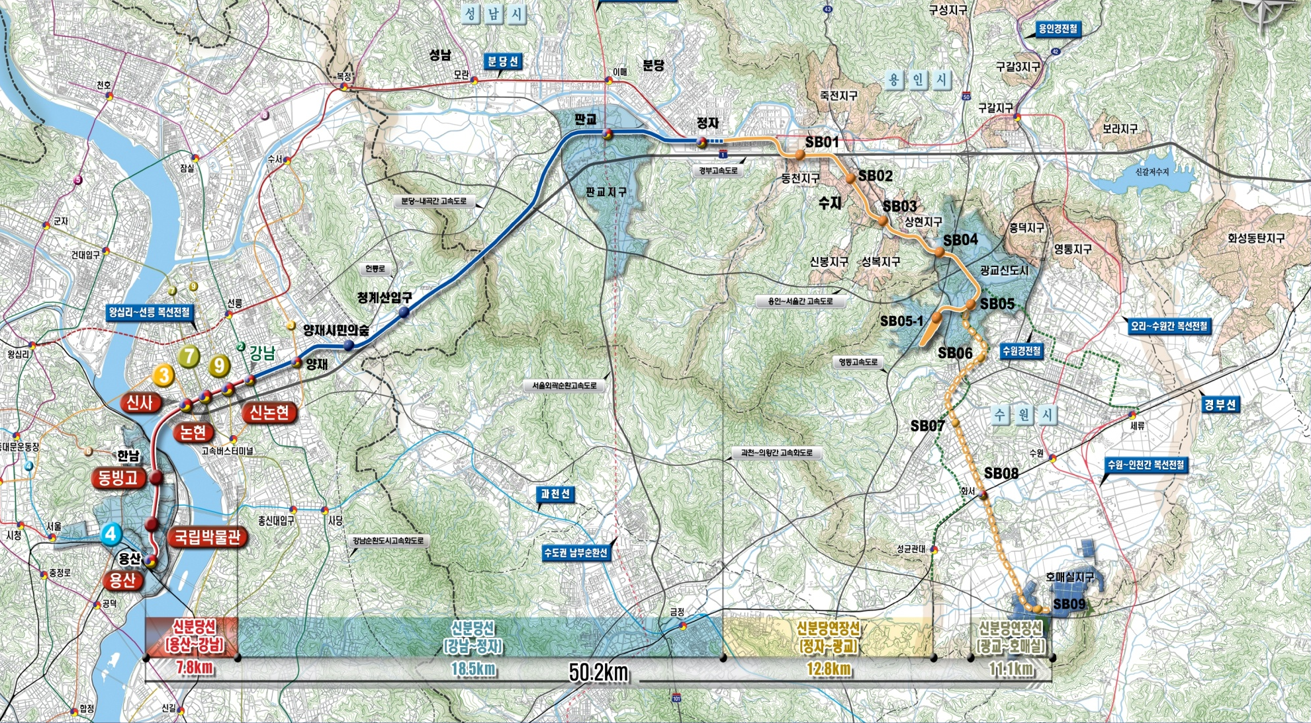
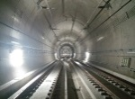
Shinbundang DX Line PPP Project : Outline
Project | Shinbundang DX Line Project (39.1km)
Location | Yongsan, Seoul ~ Gwanggyo, Suwon
Period | Construction : 5~6.5 years, O&M : 30 years
TIC | USD 4.1 Bil (EPC : USD 3.6 Bil)
3
Seoul
3
Yongsan~ Gangnam
1
Gangnam~Jeongja
2
Jeongja~Gwanggyo
East of Asia
Yongsan ~ Gangnam (7.8km)
Construction : 6 years (Aug 2016 ~ Aug 2022)
USD 1.2 Bil
Under Construction…
Gangnam ~ Jeongja (18.5km)
Construction : 6.5 years (Jul 2005 ~ Dec 2011)
USD 1.6 Bil
Now operating…
Jeongja ~ Gwanggyo (12.8km)
Construction : 5 years (Feb 2011 ~ Feb 2016)
USD 1.3 Bil
Now operating…
* Shinbundang DX Line : First domestic driverless operating subway

Slide 7
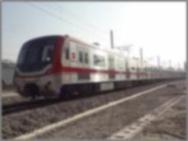
Shinbundang DX Line PPP Project : Business Model
MRG(Minimum Revenue Guarantee)
Client
Ministry of Land, Infrastructure and Transport
MRG Hurdle
(50%)
20%
Government guarantee maximum 30% of fare revenue if or is over 50% against implementation contract
30%
43%
50%
Inkind
Contribution
Implementation
Contract
O&M
Rights
EPC
Doosan E&C Consortium
EPC/O&M
SPC
Shinbundang DX Line
Loan
Debt
The Korea
Development Bank
43%
Subsidiary
EPC,O&M
Contracts
Loan agreement
O&M Neotrans
Payment
Principal and interest payments
Investments
Shareholder’s
agreement
Dividends
Equity
(CI, FI),
14%
CI＝Doosan E&C and others(7 companies)
FI＝KDB Bank and others(3 companies)

Slide 8
Shinbundang DX Line PPP Project : Cash Flow
Shinbundang DX Line Project – CI’s Cash Flow (CI = Construction + Operation)
TIC : USD 4.1 Bil
Development (5years)
Construction (5 ~ 6.5years)
Operation (30years)
CI
O&M
Construction profit 200mil USD
Invest profit 5,300mil + Operation profit 500mil USD
+
1
2
3
4
5
6
7
1
2
3
4
5
6
7
8
9
10
11
12
13
14
15
16
17
18
19
20
21
22
23
24
25
26
27
28
29
30
(5years in developing)
-
Equivalent Economic Impact (in Revenue)
Hyundai motor (Operating profit 5.55%) | Samsung (Operating profit 14.49%)
LF SONATA 4.3 million EA | Gallaxy S8 41.4 million EA
Equity 300mil USD
※ LF Sonata : 25 thousand USD/EA
Gallaxy S8 : 1 thousand USD/EA
PPP Business : Integration of High level Engineering capacities (EPC + O&M + Financial) - Preliminary developing period and cost necessary - Provides higher profits (Construction profit + Operation profit + Dividend earned)

Slide 9
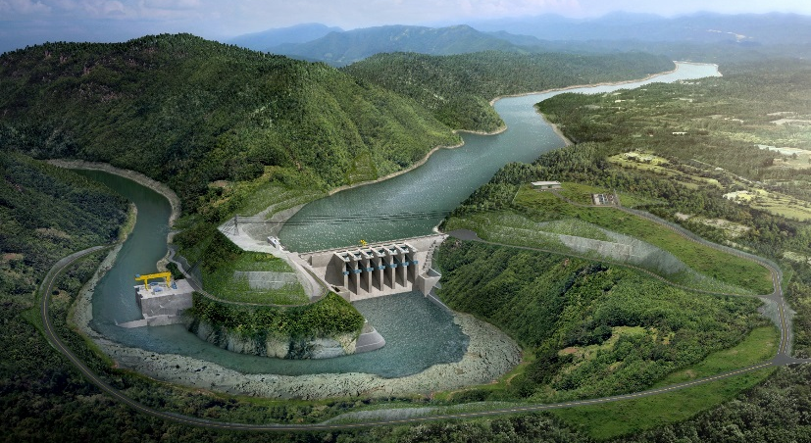
Pakistan Gulpur Hydropower Project : Outline
Kari-Muskhui 446MW
Matiltan 84MW
Bunji 7100MW
Torkum-Gudubar 409MW
Gabral Kalam 101MW
Karang 458MW
INDUS
Diamer Basha 4500MW
Yulbo 3000MW
Conspectus of the project
Kalam Asrit 197MW
Gahriat-Swir Lasht 340MW
Kaigha 548MW
Harpo 33MW
Tangus 2100MW
Asrit Kedam
215MW
Dasu 4320MW
Project | Gulpur Hydropower Project
Location | Poonch river, AJ&K, Pakistan
Capacity | 102 MW
Generating Type | Run of River
Project Type | IPP(Independent Power Purchase)
Period | Construction : 5 years, O&M : 30 years
TIC | USD 367 Mil (EPC : USD 265 Mil)
SKARDU
Skardu 1600MW
Gilgit
Baltistan
Madian 157MW
Keyal 125MW
Azad Jammu
and Kashmir
Lower Spat Gah 496MW
Spat Gah 1341MW
Bashu 28MW
NEELUM
Satpara 17MW
Yogo 500MW
Duber Khawar 130MW
Jabban 20MW
Patan 2800MW
Dargai 20MW
Palas Valley
1176MW
Jagran 30MW
Sharmai 115MW
Balakot 190MW
Allai Khwar 121MW
Patrind 147MW
Athmuqam 350MW
Malakand III 81MW
Muzaffarabad
Ashkot 700MW
Thakot
2800MW
Munda 740MW
Warsak 240MW
Neelum Jhelum
969MW
Chakothi-Hattian 500MW
PESHAWAR
Tarbela 3470MW
Kohala 1100MW
Azad
Jammu
And
Kashmir
Jammu
And
Kashmir
Ghazi Barotha 1450MW
Akhori 600MW
Harighel 53MW
ISLAMABAD
Sehra 130MW
Mahl 600MW
Kotli 100MW
Dakhari
2MW
JHELUM
INDUS
POONCH
Azad Pattan 650MW
Kuram Tangi 84MW
Karot 720MW
Gulpur 102MW
Pakistan
Gulpur
Punjab

Slide 10
Pakistan Gulpur Hydropower Project : Business Model
Client
Pakistan’s Ministry of Water and Power
DA
Direct Agreement
Private Power and Infrastructure Board
Central Power Purchasing Agency
Equity
PPA
(Power Purchase Agreement)
Debt
IA
(Implementation Agreement)
ADB | ADB
 | CCF
IFC | IFC
 | FMO
 | PBC
K-EXIM | K-EXIM
CDC | CDC
18%
SPC
(MIRA Power)
6%
25%
75%
76%
SHA
(Share Holders Agreement)
LA
(Loan Agreement)
CCF | Canadian Climate Fund
FMO | Netherland Dev. Financing Co.
PBC | People’s Bank of China
CDC | Commonwealth Dev. Corporation
EPC
O&M
Covered
PRI
(Political Risk Insurance)
DB JV
O&M JV
MIGA | Multilateral investment guarantee agency
25%
100%
75%

Slide 11
Pakistan Gulpur Hydropower Project : Cash Flow
Pakistan 500MW Hydropower Project– Investor’s Cash Flow (Except Loan)
Total investment : 1,150 million USD
development
construction
operation
Construction Profit : 100 million USD
Dividend(2,200 million USD) + Operation profit(30 million USD)
Equity recovery : 4.3yrs
70
70
70
70
70
70
70
70
70
70
70
70
72
72
72
72
+
1 | 2 | 3
1 | 2 | 3 | 4 | 5 | 6 | 7 | 8 | 9 | 10 | 11 | 12 | 13 | 14 | 15 | 16 | 17 | 18 | . . .
-
Equivalent Economic Impact (in Revenue)
Hyundai Motor (operating profit 5.55%) | Samsung (operating profit 14.49%)
LF SONATA 1.7 million EA | Gallaxy S8 16 million EA
Equity : 290 million USD
※ LF Sonata : 25 thousand USD/EA
Gallaxy S8 : 1 thousand USD/EA
Sustainable & High Value Added Model in Developing Market
20 times more profitable than build only contract

Slide 12
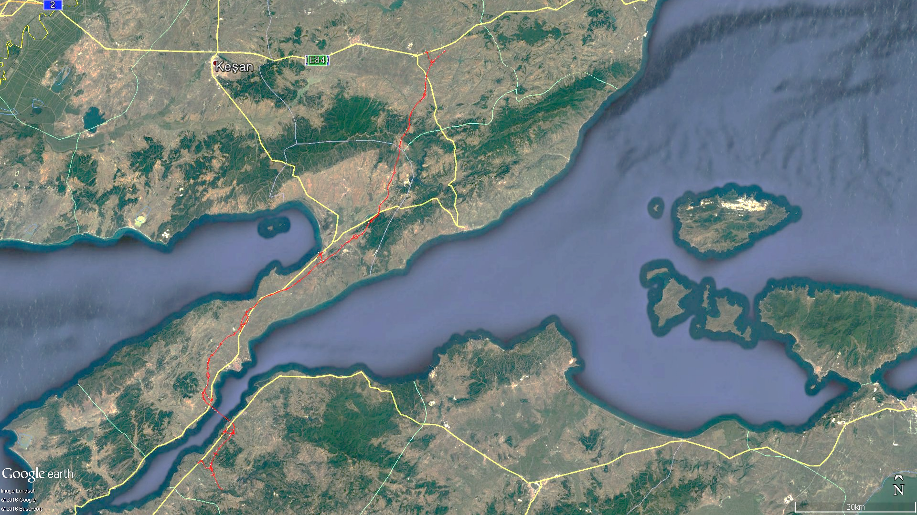
Turkey Canakkale Bridge Project : Outline
Conspectus of the project
Project | 1915 Çanakkale Bridge Project | Total investment | EUR 3,*** mil
Type | Suspension bridge (3,623m) +connection road (85km) | Construction cost | EUR 2,430 mil
Model | Build-Operate-Transfer (with MTG) | Order day | 2016.10.26
Orderer | General Directorate of Highways(KGM) Turkey | Bidding day | 2017.01.26
Kayseri→
KM105+500.000
Malkara
Saglamtas
Gazikoy
Golcuk
TEKİRDAĞ-ÇANAKKALE
74.897 km
Kavakkoy
Sarkoy
Korukoy
Bid results
Consortium |  | Period
 |  | Period | Ratio
1 | DAELIM + SK | 16years 2months 12days | 100.0%
 | Limak + Yapi Merkezi
2 | Itochu + JOIN + JEX | 17years 10months 24days | 110.4%
 | Makyol + Nurol
3 | Astaldi | 18years 5months 15days | 113.9%
 | Ictas
4 | CRMBEG | 18years 8months 19days | 115.5%
 | Cengiz + Kolin
Average Period |  | 1years 9months 26days | 110.0%
Marmara Sea
Gelibolu
Bridge 5.17km
KM180+397.204
KM185+569.000
Lapseki
ÇANAKKALE – SAVAŞTEPE
9.20km
KM194+769.733
Izmir →

Slide 13
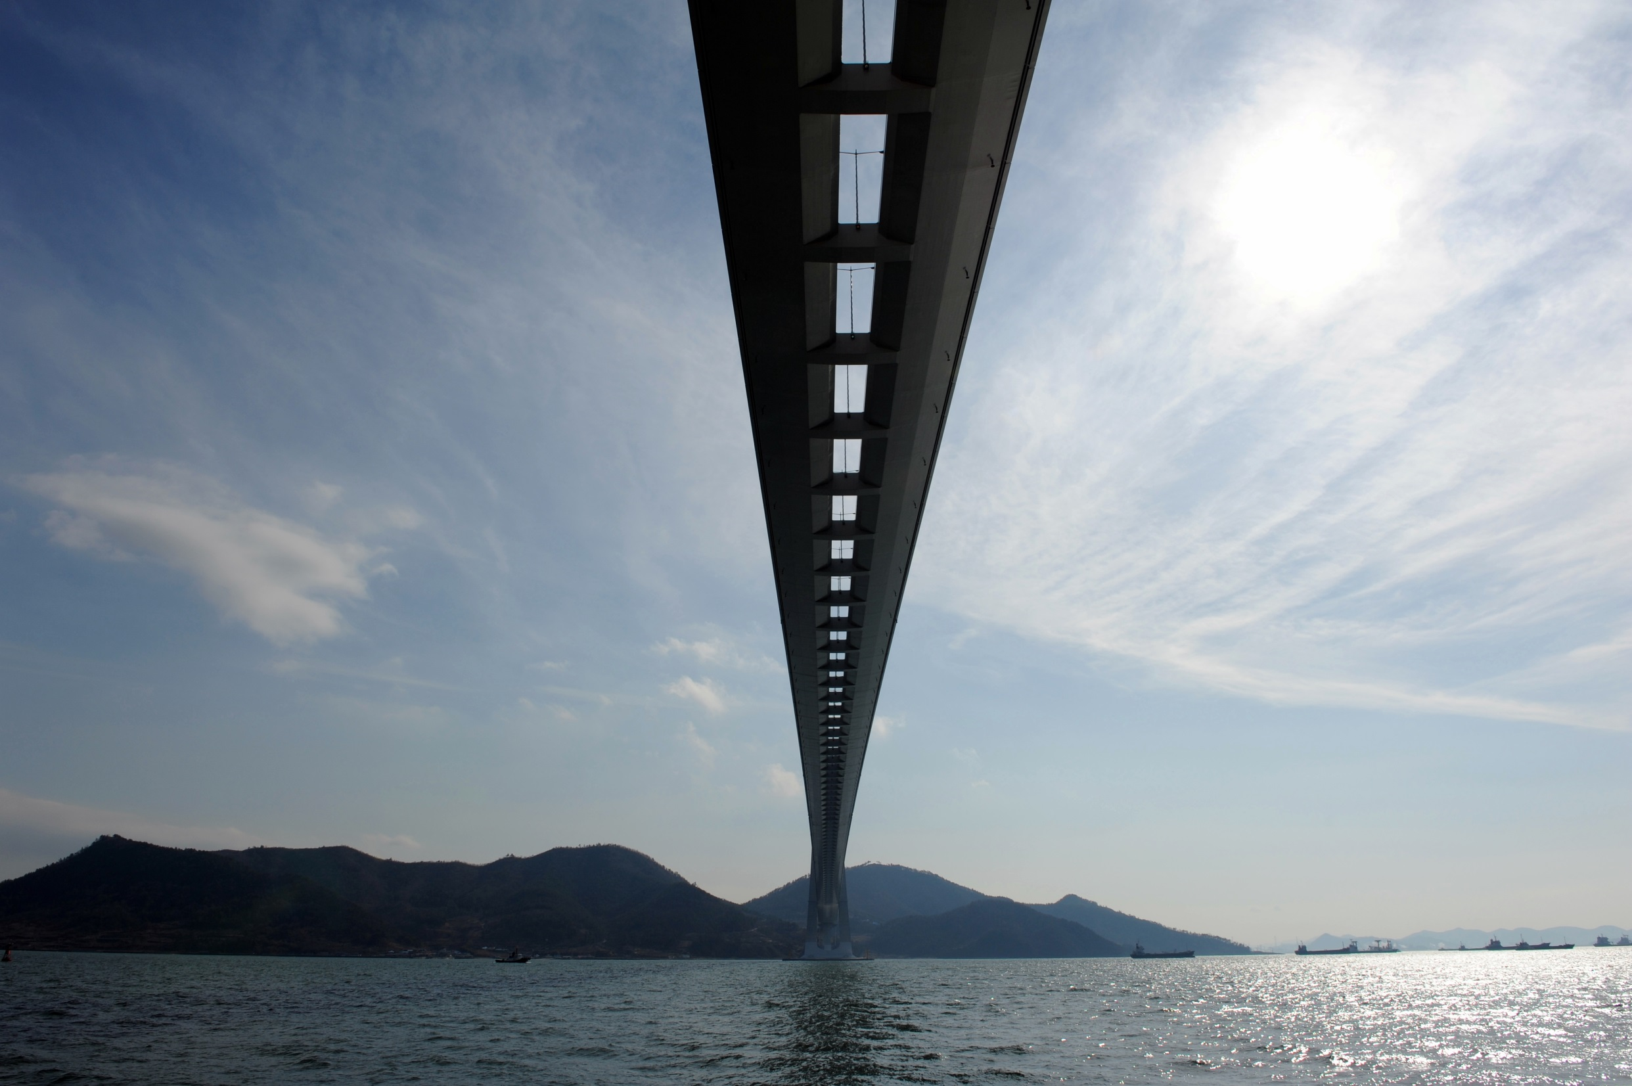
Turkey Canakkale Bridge Project : Business Model
Client
Turkey Ministry of Transport,
Maritime and communications
Turkey Ministry of Finance
KGM(Turkey)
(General directorate of highways)
DAA
(Debt Assumption Agreement)
Equity
Debt
IC
Implementation Contract
K-ECA | K-Sure K-Exim
International | ICIEC ICBC/BOC KFH EKF
Turkish Local | Garanti Yapi Kredi Vakiflar
25%
SPC
(COK IYI)
25%
25%
75%
정
SHA
(Share Holders Agreement)
LA
(Loan Agreement)
25%
25%
EPC
O&M
DB JV
O&M JV
25%
25%
25%
25%
25%
25%
25%
25%
Notes:
업무분장

Slide 14
Turkey Canakkale Bridge Project : Cash Flow
Turkey Canakkale Bridge Project– Investor’s Cash Flow
Tender
Construction
Operation
Guaranteed Revenue :
370 ~ 450 million Euro
898
Repayment of the principal and interest
Construction profit
※ Rule of the game
bidder with Minimum Concession Period
+
1 | 2 | 3 | 4 | 5 | 6 | 7 |  |  |  |  |  |  |  |  |  | 17
-
Equivalent Economic Impact (in Revenue)
Loan
Hyundai motor (Operating profit 5.55%) | Samsung (Operating profit 14.49%)
LF SONATA 1.1 million EA | Gallaxy S8 10.3 million EA
Equity : 900 million Euro
※ LF Sonata : 25 thousand USD/EA
Gallaxy S8 : 1 thousand USD/EA
Key Success Factor of PPP in Matured Market
World-Level EPC Capacity with Various Financing Network

Slide 15
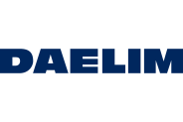
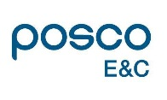
Overseas PPP Project List
Country | Company | Project | Scale | Model | Type | Progress | Partnership
Pakistan |  | Gulpur Hydropower Project | 102 MW | IPP | Hydropower | Constructing | Korea Electric Power Corporation
 |  | Lower Spat Gah Hydropower Project | 496 MW | IPP | Hydropower | Developing | Korea Electric Power Corporation
 |  | Chakothi-Hattian Hydropower Project | 500 MW | IPP | Hydropower | Developing
 |  | Patrind Hydropower Project | 150 MW | IPP | Hydropower | Test | K-Water(Korea Water Resources Corporation)
Nepal |  | Upper Trishuli – 1 Hydropower Project | 216 MW | IPP | Hydropower | Project Development Agreement | Korea Electric Power Corporation
Laos |  | Xepian Hydropower Project | 410 MW | IPP | Hydropower | Constructing | Korea Electric Power Corporation
Indonesia |  | Wampu Hydropower Project | 45 MW | BOO | Hydropower | Commercial operation | Korea Electric Power Corporation
 |  | Semangka Hydropower Project | 55.4 MW | BOO | Hydropower | Constructing | Korea Electric Power Corporation
Turkey |  | Canakkale Bridge Project | Suspension Bridge 3.5 km | BOT | Toll Road | Financing
 |  | Europe and Asia Tunnel Project | 14.6 Km | BOT | Toll Road | Commercial operation
Kazakhstan |  | Almaty Ring road | 66 km | BOT | Toll Road | Financing

Slide 16
Overseas PPP Project : Economic Impact
Country | Project | Cost (mil USD) | Profit (mil USD)
Pakistan | Gulpur Hydropower Project | 420 | 800
 | Lower Spat Gah Hydropower Project | 1,300 | 2,300
 | Chakothi-Hattian Hydropower Project | 1,400 | 2,500
 | Patrind Hydropower Project | 500 | 1,000
Nepal | Upper Trishuli – 1 Hydropower Project | 670 | 1,300
Laos | Xepian Hydropower Project | 1,100 | 2,100
Indonesia | Wampu Hydropower Project | 200 | 380
 | Semangka Hydropower Project | 220 | 420
Turkey | Canakkale Bridge Project | 3,600 | 1,500
 | Europe and Asia Tunnel Project | 1,400 | 580
Kazakhstan | Almaty Ring road | 1,000 | 410
KAZAKHSTAN
Republic of KOREA
TURKEY
NEPAL
PAKISTAN
LAOS
INDONESIA
A Korean Construction Company’s Overseas Contract | Hyundai Motor (Operating profit 5.55%) | Samsung (Operating profit 14.49%)
10 year’s Sales | LF SONATA 9.5 million EA | Galaxy S8 90 million EA
※ 2016 Korea Overseas Contract : 28.2 billion USD
USD 13 bil in profit (Equivalent USD 250 Bil in Revenue)
Economic Potential

Slide 17
Thank you !!!

