Slide 1

Assessing infrastructure gaps
OECD Perspectives
Lorenzo Casullo, Economist and Policy Analyst
Network of Economic Regulators (NER)
International Transport Forum (ITF)

Slide 2

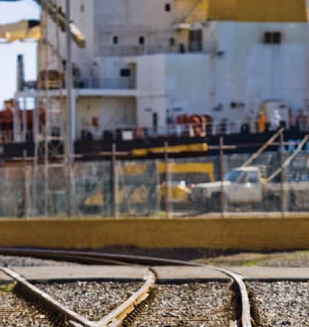
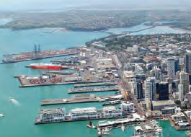
Putting infrastructure gaps in context
Every country/region may have gaps in the provision and quality of infrastructure
Gaps can be expressed in comparison to optimal levels and/or other countries’ endowments
At difference stages of development: growth in capital stock vs. efficiency of existing infrastructure
Better infrastructure supports trade, productivity, territorial cohesion and employment policies

Slide 3

Big numbers floating around
$20 billion by 2050
6% of GDP in real terms
Double capacity
8,000 per capita by 2030

Slide 4
We need a reliable approach
We propose and use a 4-step methodology to identify priority areas for investment:
Selecting comparators based on macro and geographical data
Benchmarking stock and quality of infrastructure across comparators
Analysing demand trends for medium/long run using ITF Global Transport Model
Addressing externalities

Slide 5
Case studies: our work on infrastructure
Chile
Agenda 30/30 for transport and water infrastructure
Estonia
Economic Survey of Estonia 2017 – reviving productive investment
Western Balkans
Competitiveness Outlook 2018: better transport policies for more competitive economies
Forthcoming:
Central Asia, Vietnam…

Slide 6
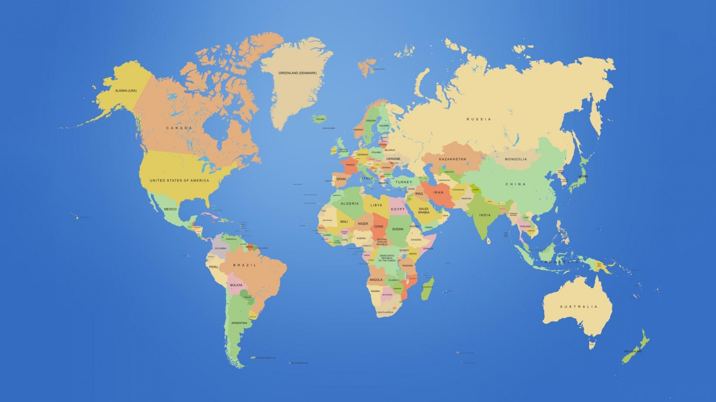
Step 1 - Selecting comparators
Notes:
The countries against which a country’s transport infrastructure is compared should not be too different in terms of economic development, population density and geography, so as to limit the exogenous variation in transport performance as much as possible.

Slide 7
Step 2 - Benchmarking stock and quality
Global Competitiveness Index, Chile and comparator countries
(1 = worst, 7 = best), average 2015-2016 and 2016-17 editions
Notes:
Starting with international indicators, we can gain an overall understanding of a country’s comparative performance.

Slide 8
Step 2 - Benchmarking stock and quality
Curves on rural roads on which traffic flows at >80 km/h that have hazardous roadsides , iRAP estimates 2015
Notes:
All the way to benchmarking the quality and safety attributes of major roads, by region.

Slide 9
Step 3 - Analysing demand trends
Evolution of transport volume indicators in Chile (2005 = 100)
Forecast

Slide 10
Step 3 - Analysing demand trends
ITF estimates of infrastructure capacity gaps by 2030 in Chile
Notes:
Identifying high-level estimates of capacity gaps – where investment is most needed by 2030

Slide 11
Step 4 - Addressing externalities
Mean population exposure to PM2.5 (micrograms per cubic metre), 2005 and 2013
Notes:
But infrastructure produces externalities and simply adding more is not always the solution to ancillary problems such as pollution and safety, but also take into account natural hazards such as rising sea levels, earthquakes, etc.

Slide 12
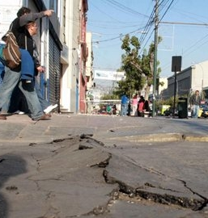

A multi-modal scorecard to guide infrastructure planning and investment
The OECD/ITF approach helps member countries identify infrastructure gaps
A balanced assessment across modes that makes use of benchmarking, modelling and dialogue with stakeholders
Instead of searching for a magic number, multi-modal scorecards guide decision-makers through complexity
A good assessment needs to be accompanied by funding and governance analysis
Notes:
Construction chambers are a very important stakeholder in this dialogue.
For example in Chile we found that:
- PGE absolutely necessary
Doubling rail capacity to serve container ports
Invest in secondary road network to reduce exclusion and improve safety
Protect public transport infrastructure in cities

Slide 13
Assessing infrastructure gaps
Thank you
lorenzo.casullo@oecd.org

